Slide 1
CH4203: Organic Synthesis Laboratory
----------------------------------------------------------------------------------------------
Expt. No. 4:
L-Proline Catalyzed Asymmetric Aldol Reaction of Acetone with p-Nitrobenzaldehyde
Instructor: Prof. Alakesh Bisai
Dept. of Chemical Sciences
Tutor: Mr. Pranay Shyamal (Roll No.: 19RS090)
& Mr. Monosij Nandy (Roll No.: 21RS008)

Slide 2
Experimental Procedure

Slide 3
Experimental Procedure

Slide 4
Experimental Procedure

Slide 6
Experimental Procedure

Slide 7
Experimental Procedure

Slide 8
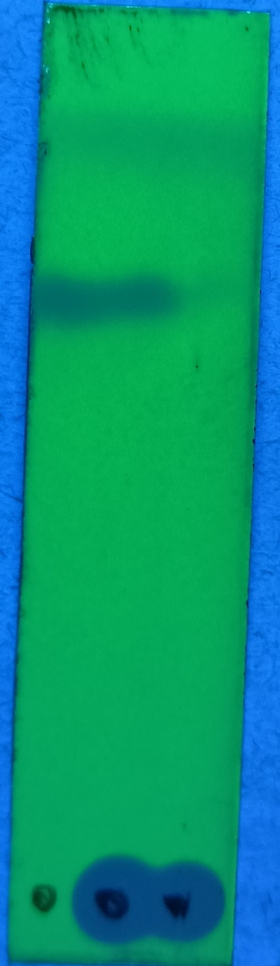
TLC Experiment
Solvent Front (∼ 3.6 cm)
UV active (Starting
Material
Product
Mobile Phase: 50% Ethyl Acetate in n-Hexane

Slide 9
Results & Observation

Slide 10
Characterization of Product

Slide 11
Conclusions

Slide 12
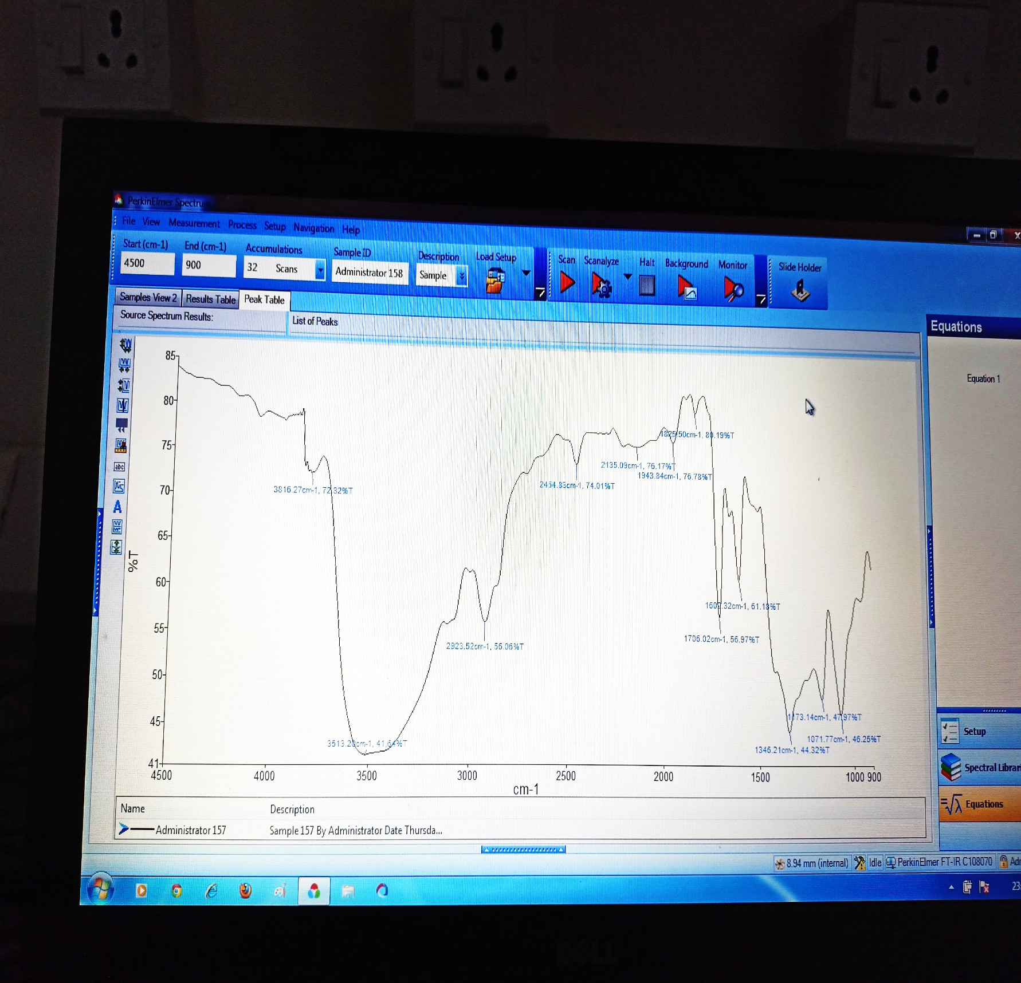
IR Data of Aldol Product (β-Hydroxy Ketone)

Slide 13
1H-NMR of Aldol Product (β-Hydroxy Ketone) in CDCl₃ – 500 MHz

Slide 14
13C-NMR of Aldol Product (β-Hydroxy Ketone) in CDCl₃ – 126 MHz

Slide 15
HPLC Analysis of Racemic Aldol Product (β-Hydroxy Ketone)

Slide 17
HPLC Analysis of Enantioenriched Aldol Product (β-Hydroxy Ketone)

